Slide 1
Planning progressive lessons in primary p.e.
Early
First
Second
Third

Slide 2
Calendar overview (suggested)
Stage | Aug | Sep | ESSD Sports Week | Maths Week Scotland | Oct | Nov | Dec | Jan | Feb | Mar | Apr | May | Jun
Early (P1-3)
First (P3-5)
Second (P6-7)
P1 & 2: focus on FMS and Play. Sugg

Slide 3
Working timetable Working Area:_________________________
DAY | 9.30-10.30 |  | 10.45-11.45 |  | 1.00-2.00 |  | 2.00-3.00
MONDAY
TUESDAY
WEDNESDAY
THURSDAY
FRIDAY

Slide 4
Week/Day | Warm up | Skills focus | Game/Application | Cool Down/Relaxation | Equipment needed
1
2
3
4

Slide 5
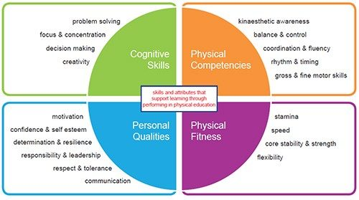
Lesson/Block planner
 | I can (success criteria)

Slide 6
Game template
FOCUS
Description | Organisation | Equipment Required
Age/Class
Benchmarks Covered

